Slide 1
GenomePro 2.0 Team Members: Guido Ruiz & Mardoqueu Mesquita Product Owner: Michael Robinson Instructor: Masoud Sadjadi School of Computing and Information Sciences Florida International University
Senior Project Final Presentation Fall 2015
December 11, 2015
Notes:
Greet your audience, thank them for attending your presentation, introduce yourself, introduce your project, introduce your team members, and quickly indicate what each of you did in a high-level manner, and put more emphasis on your part/contribution.

Slide 2
Problem Definition
Whole Project:
Develop a tool for Biomedical Engineers
To find patterns in Genomes
To predict sickness and develop cures
My Part:
Back-end expert
Created PHP structures and controllers
Created libraries and database schema
Notes:
Introduce the problem that the whole project tackles and stay focused on the parts that you have been working. Indicate if there is an existing previous system, enumerate its problems/limitations, etc.

Slide 3
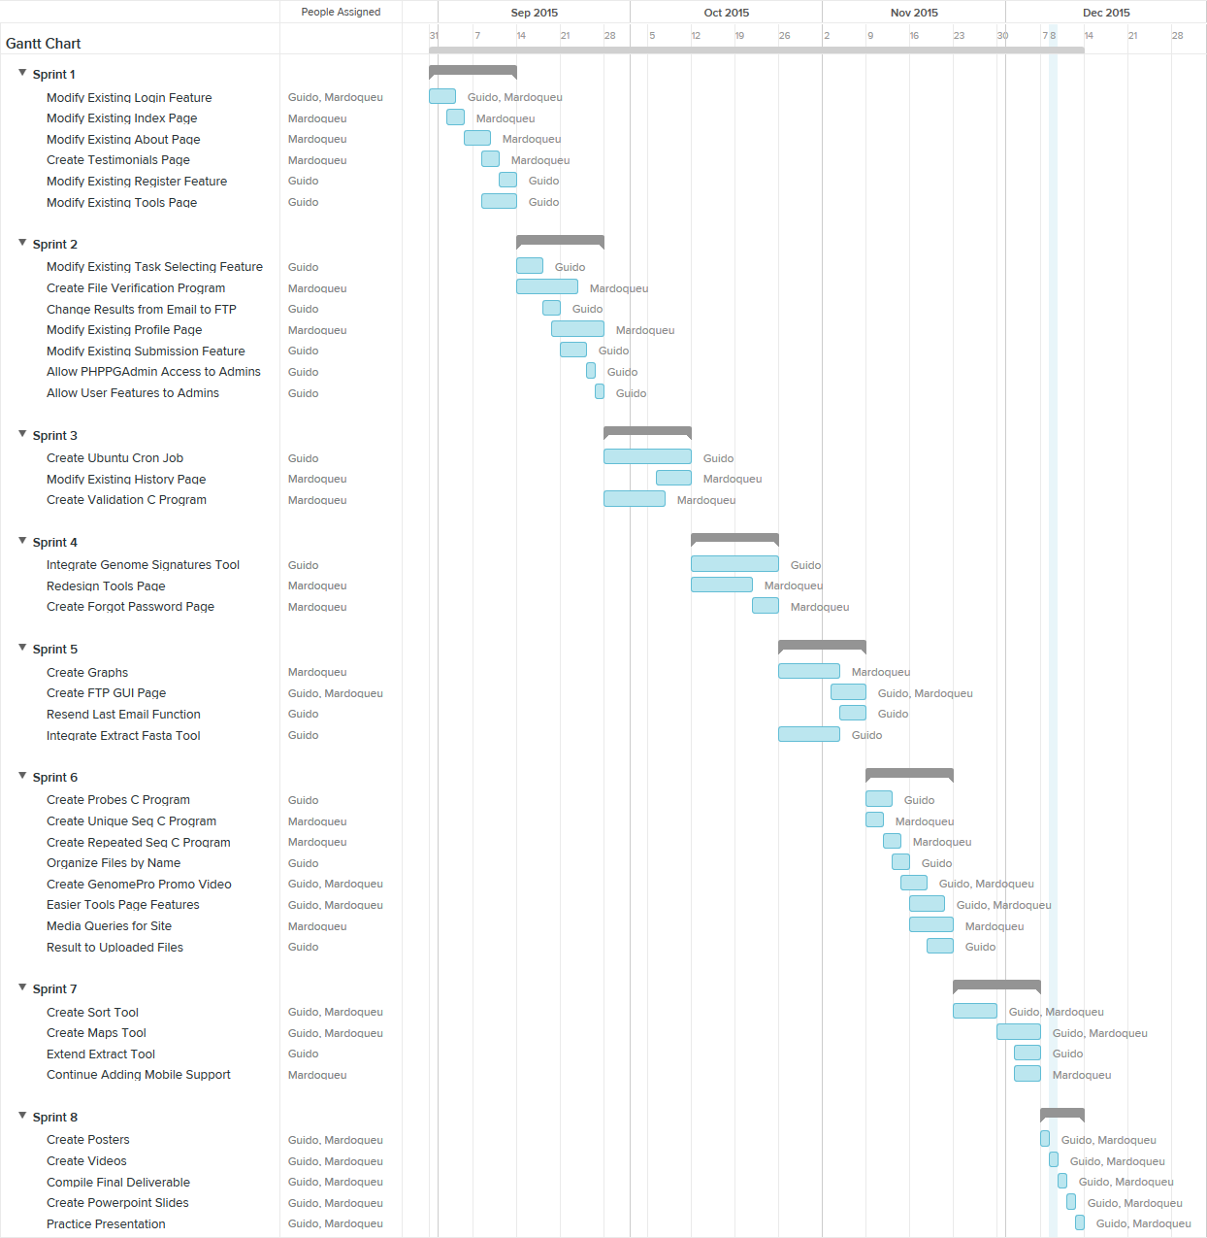
Gantt Chart
Notes:
Project Management (schedule for entire semester) (one slide; Gantt Chart).

Slide 4
User Stories
I worked solemnly on:
Modifying register and tools page
Modifying the backend on job processing
Integrating tools: Probes and Signatures
FTP Page for registered users
Creating CRON jobs for the system
Admin access to user features and database
Adding Job chaining functionality
Other user stories were a collaboration, or only by Mardoqueu
Notes:
4. Requirements:
4.1. User stories implemented (one or more slides).
4.2. UML use cases and the use case diagram for the implemented use cases (one or more slides).
4.3. UML sequence diagrams for the implemented use cases.

Slide 5
User Stories
Most significant user story was to create a CRON job queue for the system.
Jobs are now processed every minute
No overlapping
FCFS (FIFO) fashion
Before, jobs were processed when submitted
Big jobs led to a frozen site for a long time

Slide 6
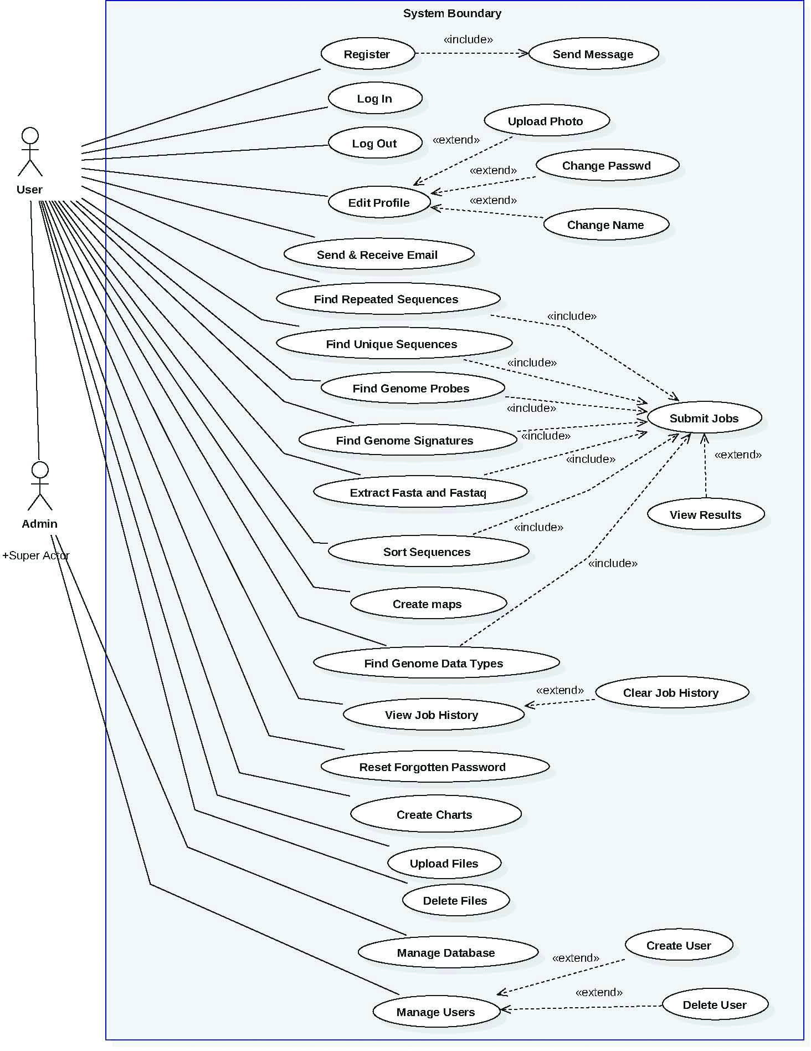
Use Cases
Total of 29 use cases
Admin actor is a super of User
Notes:
4. Requirements:
4.1. User stories implemented (one or more slides).
4.2. UML use cases and the use case diagram for the implemented use cases (one or more slides).
4.3. UML sequence diagrams for the implemented use cases.

Slide 7
User Stories
Most significant use case was to redesign the way users submit jobs.
Tools page more intuitive
Multiple job submission support
Complex jobs with arguments supported
Good validation system in place
History support

Slide 8
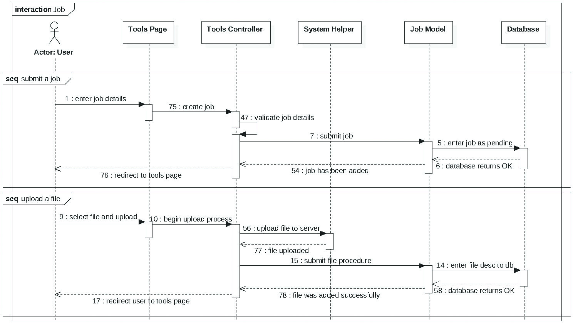
Sequence Diagrams - Jobs
Notes:
4. Requirements:
4.1. User stories implemented (one or more slides).
4.2. UML use cases and the use case diagram for the implemented use cases (one or more slides).
4.3. UML sequence diagrams for the implemented use cases.

Slide 9
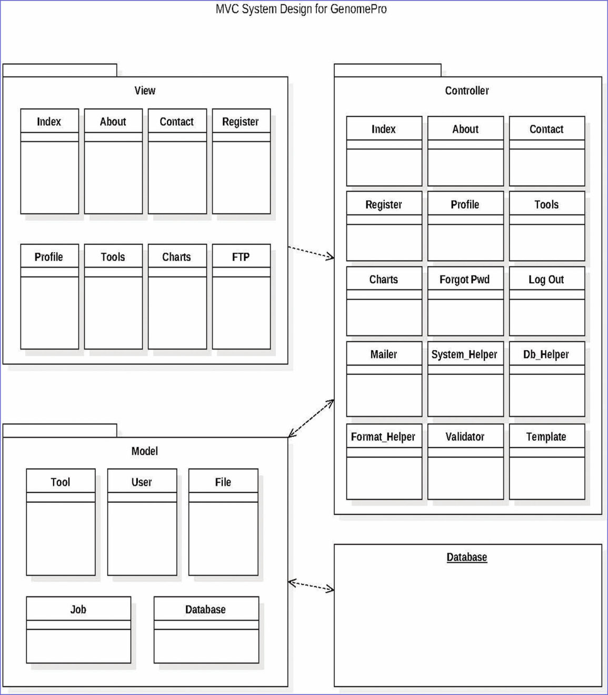
System Design & Decomposition
Modularity & Scalability is key
MVC used
Contributed controllers and models

Slide 10

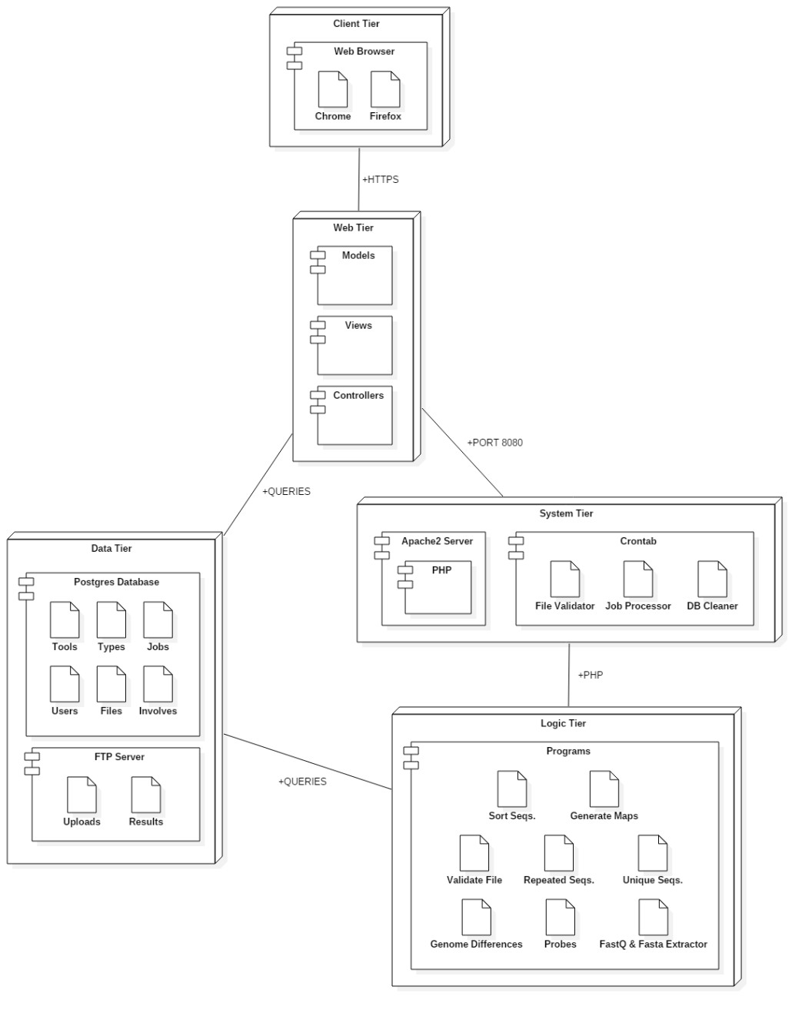
Deployment Diagram
5 tiers: Client, Data, System, Logic & Web
Limiting connections promotes security
Any tier easily swappable

Slide 11
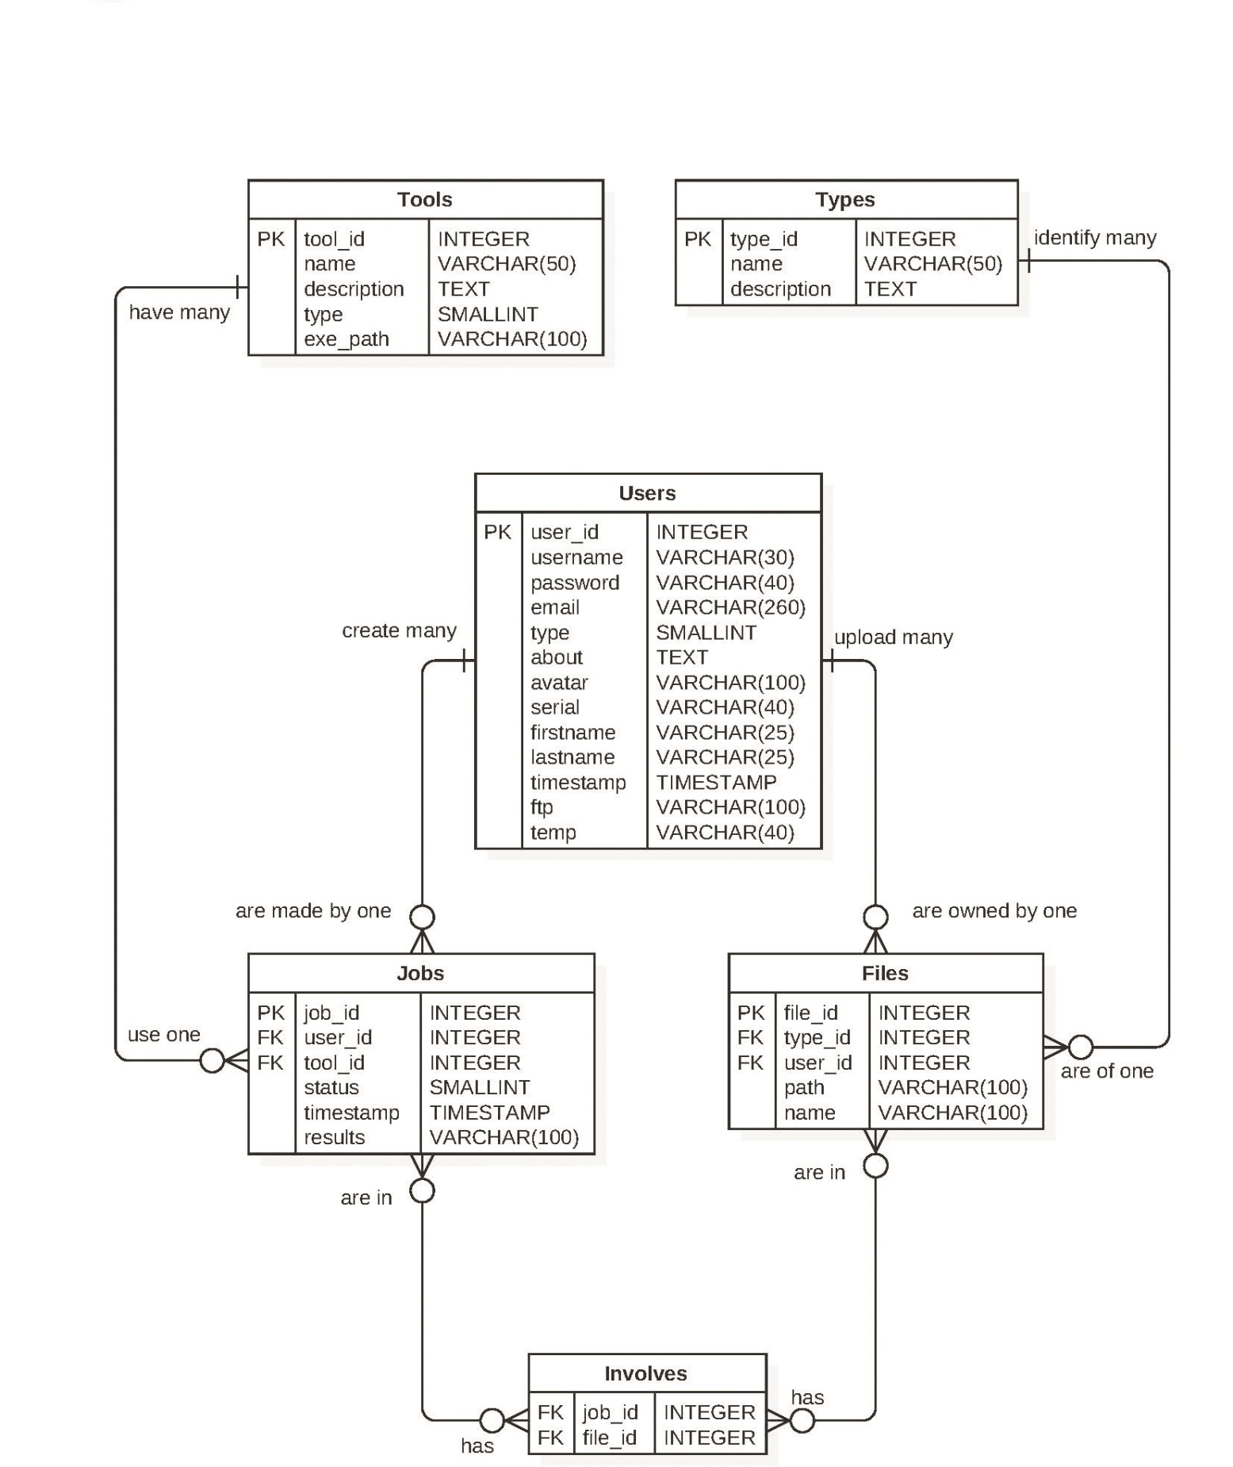
Database Modeling
Geared towards Tools
Normalized to 3NF
Every one to many contain primary keys

Slide 12
Security and Privacy
Prepared Statements
Prevents SQL injection
Automatic Logout
Protects user’s sensitive data
FTP Password
Authentication when accessing FTP
Even if the user is logged into the site
Protects from stealing a link to someone’s file
Notes:
5. System design:
5.1. System decomposition; identify the architecture patterns used (one slide).
5.2. System deployment – h/w and s/w requirements (one slide).
5.3. Persistent data design (one slide).
5.4. Security/Privacy (one slide).

Slide 13
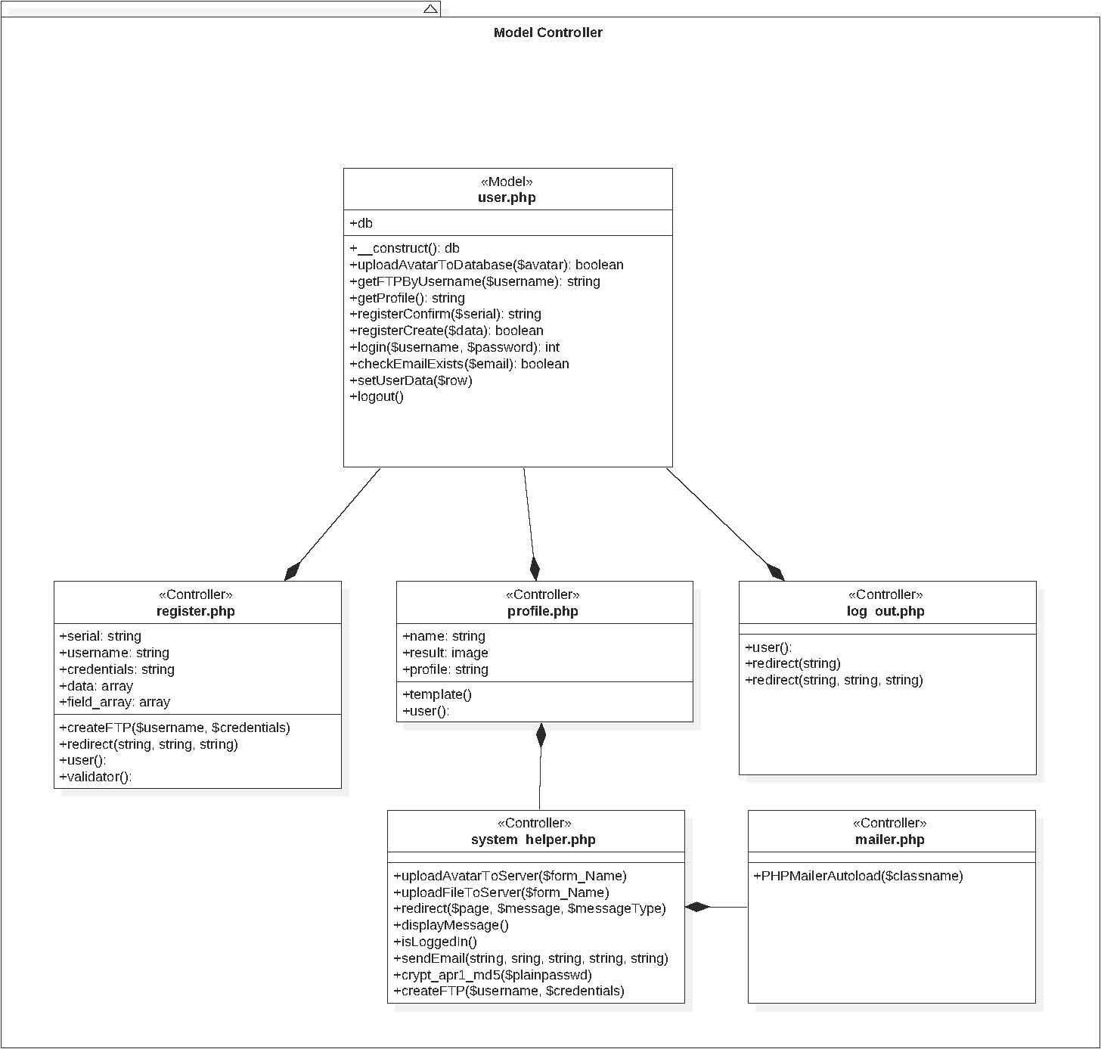
Model - Controller
User model handles related retrieval from the database
Used by controllers including register and profile

Slide 14
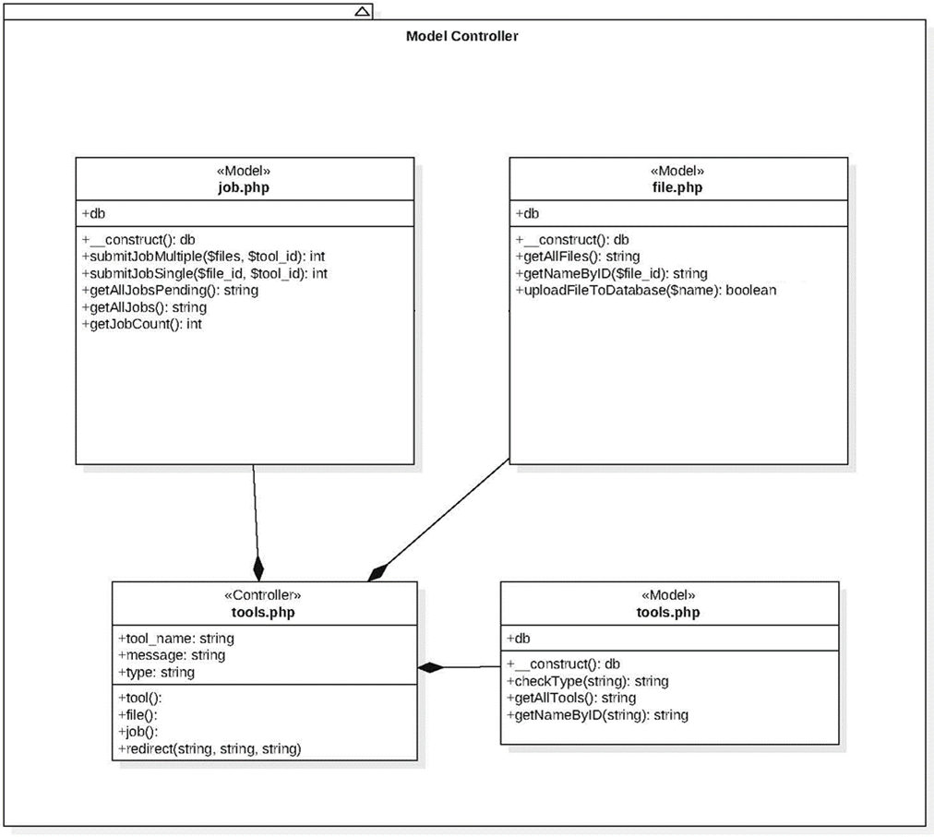
Model - Controller
User model handles related retrieval from the database
Used by controllers including register and profile

Slide 15
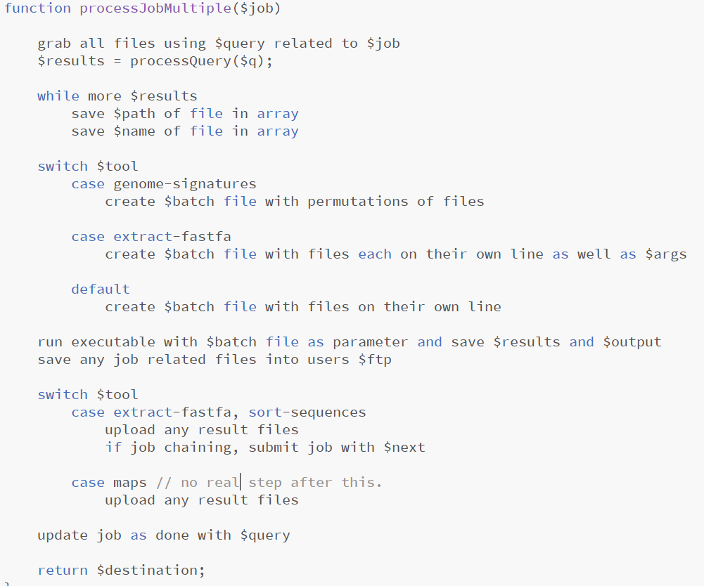
Main Algorithm
Notes:
6. Detailed design:
6.1. Minimal class diagram. Identify the design patterns used (one or more slides).
6.2. State machine for the main control object or the most important object of the implemented uses cases (one or more slides).
6.3. Main algorithm used related to an implemented use case described above (one or more slides).

Slide 16
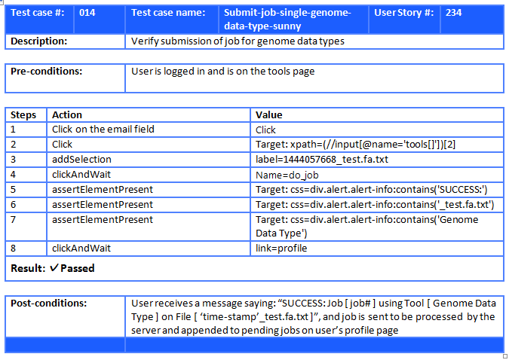
Test Case (Sunny)
Notes:
7. Test Suites and Test Cases (one sunny day and one rainy day) for the use case represented in part (5) above (2 slides).
7.1 One sunny day and one rainy day for the implemented use cases (one or more slides).
7.2 Automated test scripts for the implemented use cases (one or more slides).

Slide 17
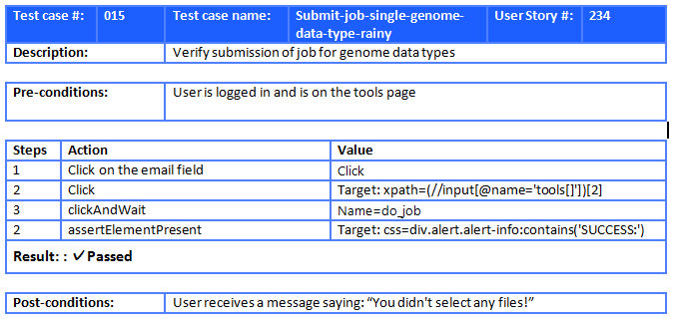
Test Case (Rainy)
Notes:
7. Test Suites and Test Cases (one sunny day and one rainy day) for the use case represented in part (5) above (2 slides).
7.1 One sunny day and one rainy day for the implemented use cases (one or more slides).
7.2 Automated test scripts for the implemented use cases (one or more slides).

Slide 18
Summary
GenomePro hopes to be as useful as a scientific calculator is to a Mathematician
This project is all about interdisciplinary collaboration, making CS a supplement!
Guido Ruiz (guidoruiz4@gmail) Any Questions? THANK YOU!
Notes:
Summarize your contribution
Include your contact information
Ask if anyone has any questions for you.
Thank your audience

